Slide 1
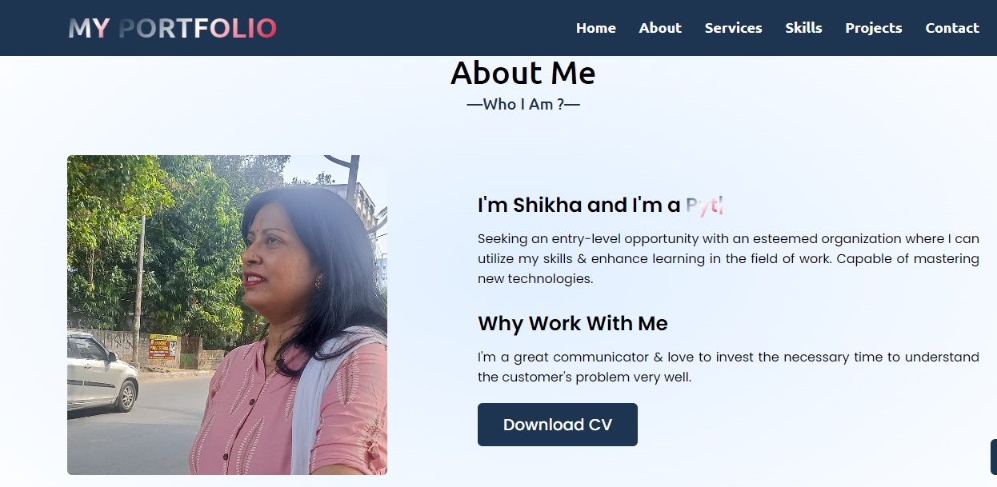
Web hosting Static​ File in IBM Cloud
CREATEDBY–Shikha Kumari

Slide 2
AGENDA
 | Title
1 | Problem Statement
2 | Project Overview
3 | Why we need this?
4 | How it help people?
5 | Solution
6 | Modelling
7 | Result

Slide 3
Problem Statement
Host static files on IBM Cloud using IBM Cloud Object Storage.
Create a storage instance, upload files to a bucket, note API key and endpoint.
Deploy a simple web app on IBM Cloud Foundry with the static file build pack.
This can help protect against outages, safeguard against data loss, and help support disaster recovery strategies.

Slide 4
Project Overview
Object Storage starts with creating a bucket and configuring it for public access.
upload your website content to your bucket.
IBM Cloud Object Storage is a parallel storage system and provides concurrent access from anywhere with an any-to- any-to any architecture.

Slide 5
Why we need this?
Object-based storage has emerged as the preferred method for data archiving and backup.
It offers a level of scalability not possible with traditional file- or block-based storage.
Efficiently host static files on IBM Cloud to ensure reliable, scalable, and globally accessible storage, optimizing web application performance and user experience.​

Slide 6
How it will help people?​
Hosting static files on IBM Cloud ensures fast, reliable, and globally accessible content delivery, enhancing user experience, and optimizing web application performance.
It provides a scalable solution with robust storage infrastructure, benefiting developers and businesses in delivering content seamlessly to end-users.​

Slide 7
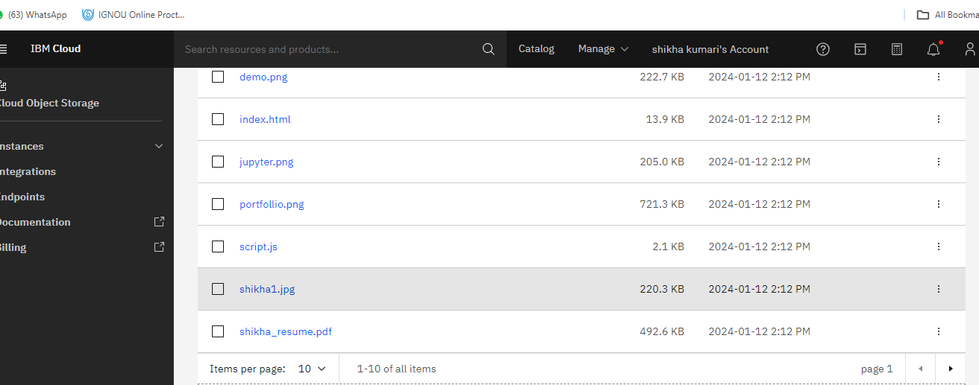
Solution

Slide 8
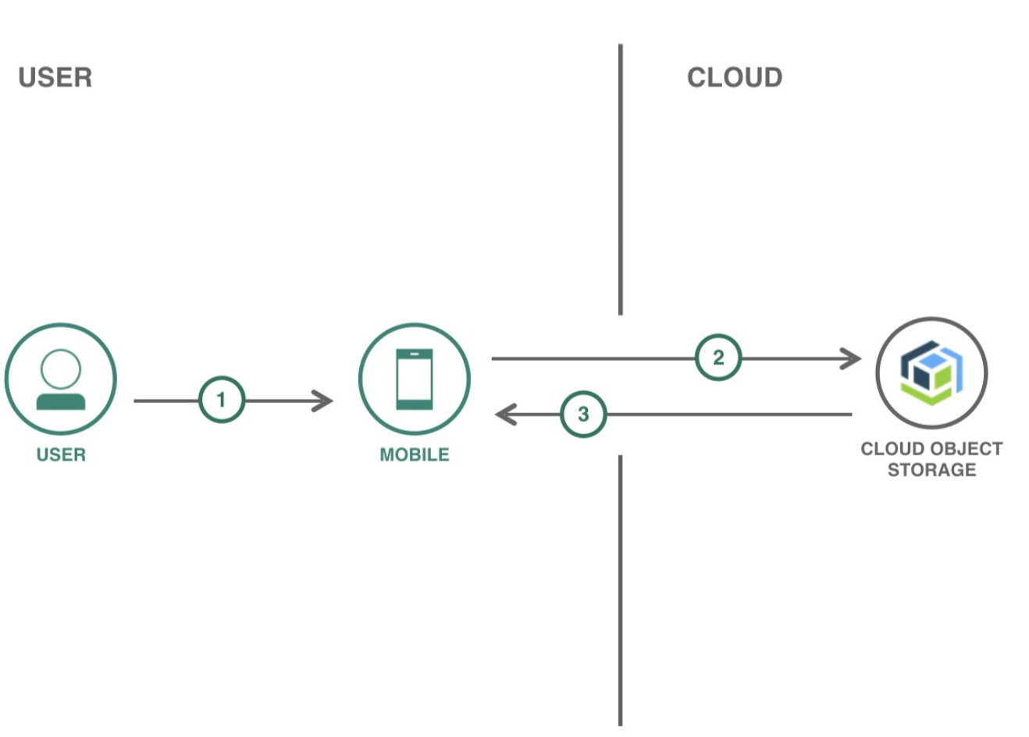
Modelling

Slide 9

Result
This results in a performant, secure, and scalable infrastructure for hosting static files, supporting diverse use cases from simple websites to complex web applications and web hosting in IBM cloud object storage projects.​
HOSTING WEBSITE: https://cloud-object-storage-cos-static-web-hosting-avu.s3.jp-tok.cloud-object-storage.appdomain.cloud/index.html
​

Slide 10
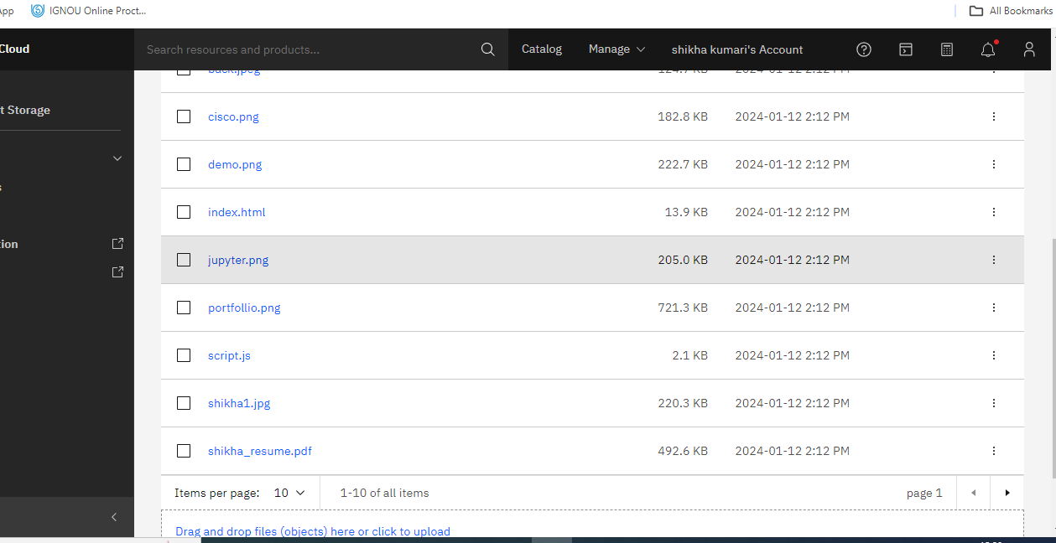
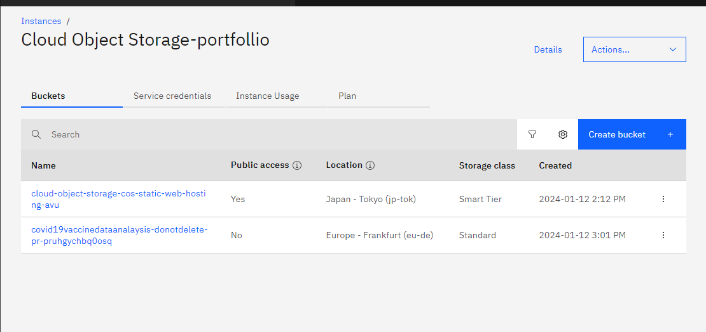
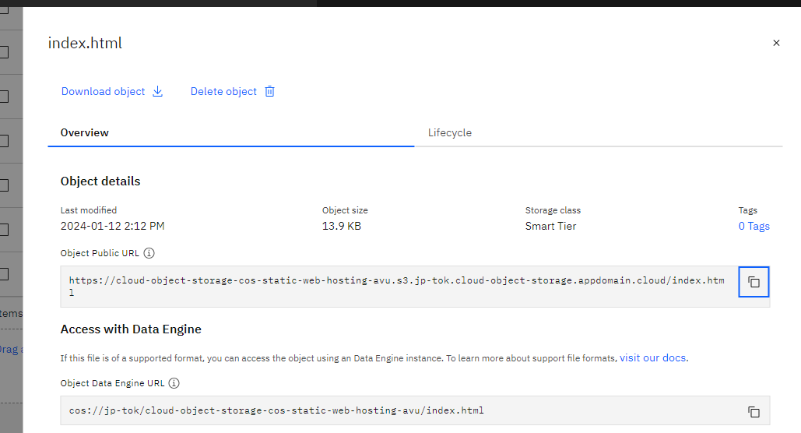

Slide 11


